Slide 1
IAEA Support to Member States in Small Modular Reactors (SMRs) and Micro-reactors (MRs) through Interregional Project INT2023
June 2022
Mr Zhang Jing (PMO) and Ms Kirsten Glenn (Assistant to the PMO)
Department of Technical Cooperation Division for Europe (TCEU)

Slide 2
TC Programme - Overview
The Technical Cooperation (TC) programme is the IAEA’s main vehicle for delivering services from across the house to Member States
The Department of Technical Cooperation is responsible for managing the TC programme.
The Technical Departments NE, NA, NS, are responsible for the technical integrity of the programme

Slide 3
TC Programme Delivery Mechanisms
Aims to support sustainable socioeconomic development in Member States
TC Projects
National
Regional
Interregional
Capacity building
Networking
Knowledge sharing
Partnership building
Equipment & materials
Expert missions
Fellowship training & scientific visits
Conferences, symposia & seminars
Training courses & workshops
Notes:
So what does the programme do?
The main function of the TC programme is to assist in building national capacity of MSs in the peaceful application of nuclear science and technology.
The programme also facilitates networking and knowledge sharing, and very importantly, the development of suitable partnerships at all levels. Because the IAEA is not the lead UN agency in agriculture, health or environment, we strive to work with FAO, WHO and UNEP in implementing projects in these fields. Our cooperation with the FAO is formalized and long established, and our cooperation with WHO is also of long standing, particularly in the area of cancer.
The main mechanisms the TC programme uses are human resource building and procurement. For human resource building, we have training courses, workshops, and individual or group fellowships. We support conference and symposia which share knowledge and exchange technical information. We send expert missions and arrange scientific visits to transfer technology and share experience among MSs.
We also provide equipment and material which contribute to the institutional capacity building.
All these support is guided by requests by Member States, in accordance with national priorities.

Slide 4
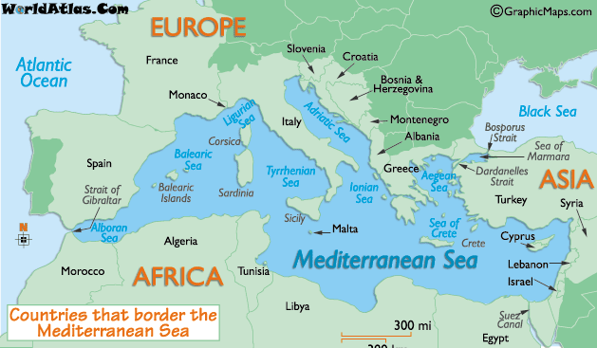
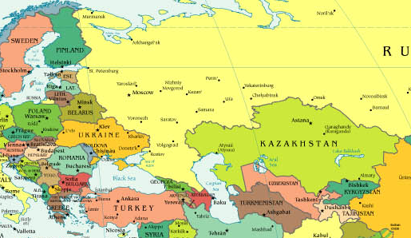
TC Project Modalities
National Projects
Regional Projects
Interregional Projects

Slide 5
INT/2/023 - SMRs: Project Background
Project Title: Supporting Member States’ Capacity Building on Small Modular Reactors and Micro-reactors and their Technology and Applications as a Contribution of Nuclear Power to the Mitigation of Climate Change
Duration: 2022–2025 (4 years)
FoA 6: Nuclear Power Reactors
Funding sources: TCF 1,053,675 EUR EBT 1,231,125 EUR

Slide 6
INT/2/023 Project Objectives
Support Member States in the deployment of Small Modular Reactors (SMRs) and Micro-reactors (MRs)
Enable national stakeholders to understand key characteristics of SMR and MR technologies and their applications – to formulate, in line with IAEA Safety Standards, country specific legal and regulatory frameworks, as well as generic user requirements and criteria for SMR technologies
Enabling effective capacity building through training and technology transfer activities on all aspects of SMR development, including siting, design; technology; engineering, construction, commissioning, operation, maintenance, human resource management; fuel cycle; waste management; decommissioning; economics; financing; nuclear safety and security; emergency preparedness and response arrangements; and legal framework
Sharing of regulatory experience and user requirements among countries
Supporting participating countries to receive technical assistance to evaluate contribution of SMRs and MRs and their potential electric and non-electric applications (in line with SDGs 6, 7, 9, 12 and 13)

Slide 7
INT/2/023 Beneficiaries
Current main recipient countries recommended by the Secretariat (38): Algeria*, Argentina*, Belarus*, Bolivia*, Brazil*, Chile, Croatia*, Czech Republic*, Egypt*, Estonia*, Ghana*, Indonesia*, Islamic Republic of Iran*, Israel, Jamaica*, Jordan*, Kenya*, Libya*, Malaysia*, Mexico*, Morocco*, Nigeria*, Pakistan*, People’s Republic of China*, Republic of Latvia*, Republic of Tunisia*, Peru, Philippines*, Poland, Qatar, Romania*, Saudi Arabia*, Singapore*, South Africa, Sri Lanka*, Sudan*, Turkey and Zambia
Current main donors’ countries recommended by the Secretariat (16): Australia, Belgium, Canada, Czech Republic, Denmark, Finland, France, India, Italy, Japan, People’s Republic of China, Republic of Korea, South Africa, Russian Federation, United Kingdom and United States of America
Notes:
Countries marked with a star* have so far confirmed their participation (call of interest still ongoing until end of January 2022) Countries marked in blue are both donor and recipient countries

Slide 8
INT/2/023 Status and work to date
Comprehensive INT2023 SMRs project developed, approved by BoG, kicked-off in January 2022
Internal core team established: TC PMO, main TOs from NE & NS
Further TOs from other TDs assigned to project and approved by SHs following review of workplan and technical content of all activities
Finalizing activity date and venues for 2022, meeting rooms reservation at HQ, as well as reaching out to host countries to scope out interest to implement activities in 2022 and 2023
Interested recipient MSs contacted and invited to formally participate and national counterparts assigned
Potential donors contacted (China, Denmark, Finland, France, Japan, Russian Federation and USA) to scope out availability to support project (through in-kind contributions, funding of activities, hosting of events, provision of experts, etc)
Internal coordination in particular with the project INT2021 ensured, to avoid duplication of activities

Slide 9
INT/2/023 Next steps
Continue reaching out to donors seeking opportunity to secure resources and hosting of activities;
Continue reaching out to interested Member States to see if they would like to formally join the project;
Implementation of activities taking place in 2022 as well as activities planned for 2023

Slide 10
Estimated Costs: TCF and Footnote/a activities proposed under INT2023
Year | Type of cost | Amount (€)
2022 | TCF | 554,400
 | EBT | 330,225
2023 | TCF | 223,650
 | EBT | 548,100
2024 | TCF | 170,625
 | EBT | 226,800
2025 | TCF | 105,000
 | EBT | 126,000
Total | TCF | 1,053,675
 | EBT | 1,231,125

Slide 11
Thank you!
Notes:
Thank you!

